Slide 1
Power into Refrigerator
125 V
.24 A
125 VAC
NO
DC+
COM
RELAY
DC -
Fan
NC
IN
Temp Sensor
Buck?
5V
125 V
0.9 A
38
1
ESP32
37
AC -
2
AC +
DC +
DC -
3
36
4
35
AC/DC Converter
5
34
Compressor
33
COM
32
NC
NO
31
30
29
RELAY
28
12
27
13
26
DC -
14
25
IN
DC+
15
24
16
23
17
22
18
21
19
20
CLK
7 Segment
DIO
VCC
GND

Slide 2
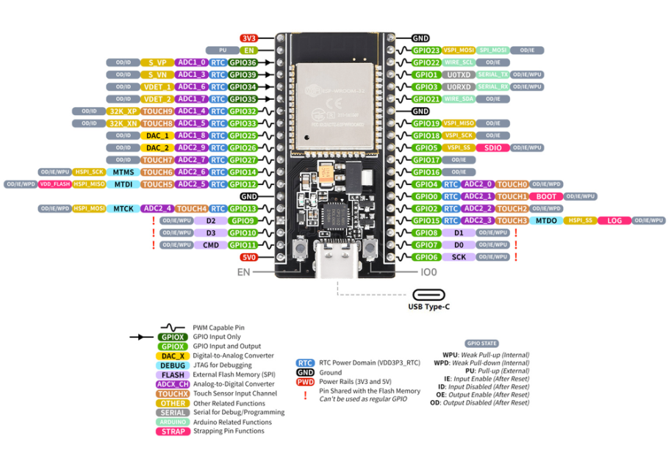
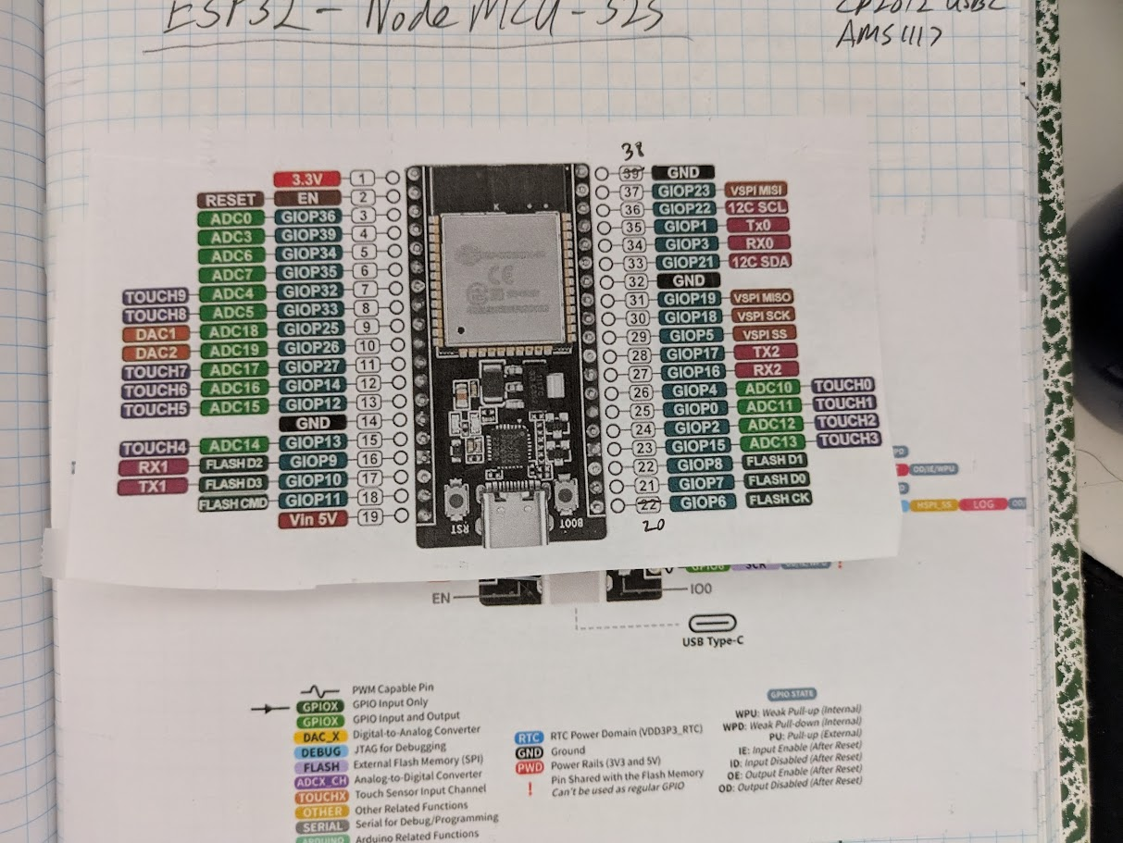

Slide 3
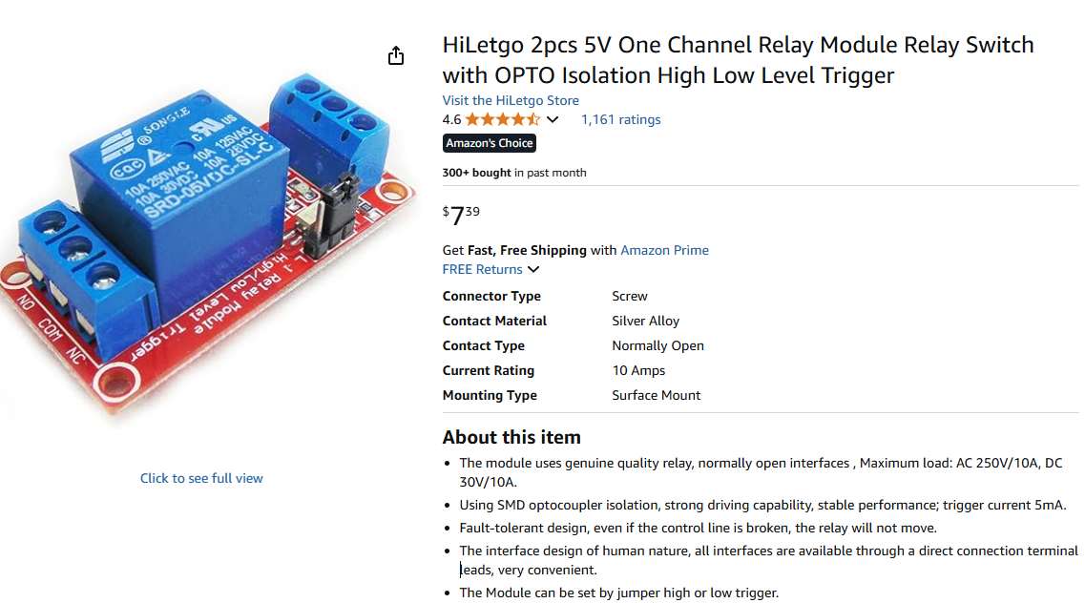
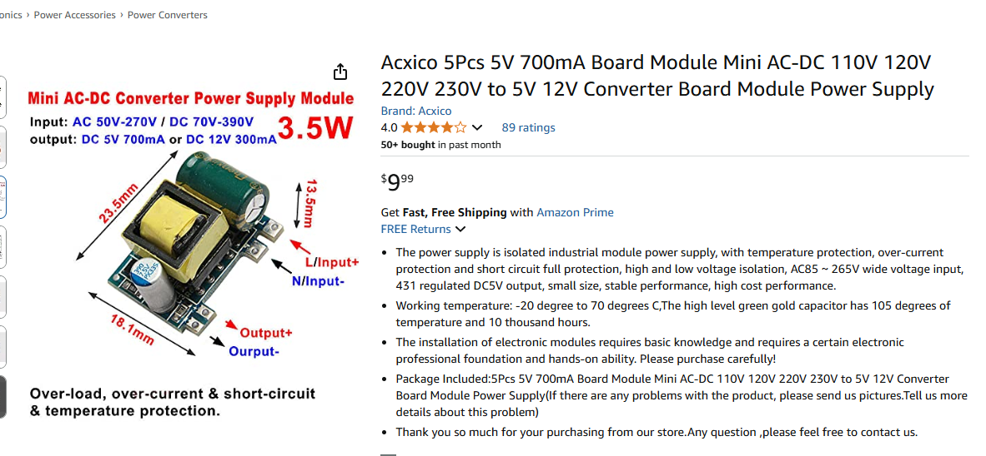
120 V
.24 A
Power into Refrigerator, 120? V
Fan
Relay
Relay
AC to DC Power Converter (5V)
120 V
0.9 A
Compressor
5V
ESP32
7 Segment
Resistor
LED Lights

Slide 4
